Slide 1
MSc Data Science
Energy Consumption Analysis and Optimizations for Scottish Councils

Slide 2
Motivation, Aims and Objectives

Slide 3
Design / Project Plan

Slide 4

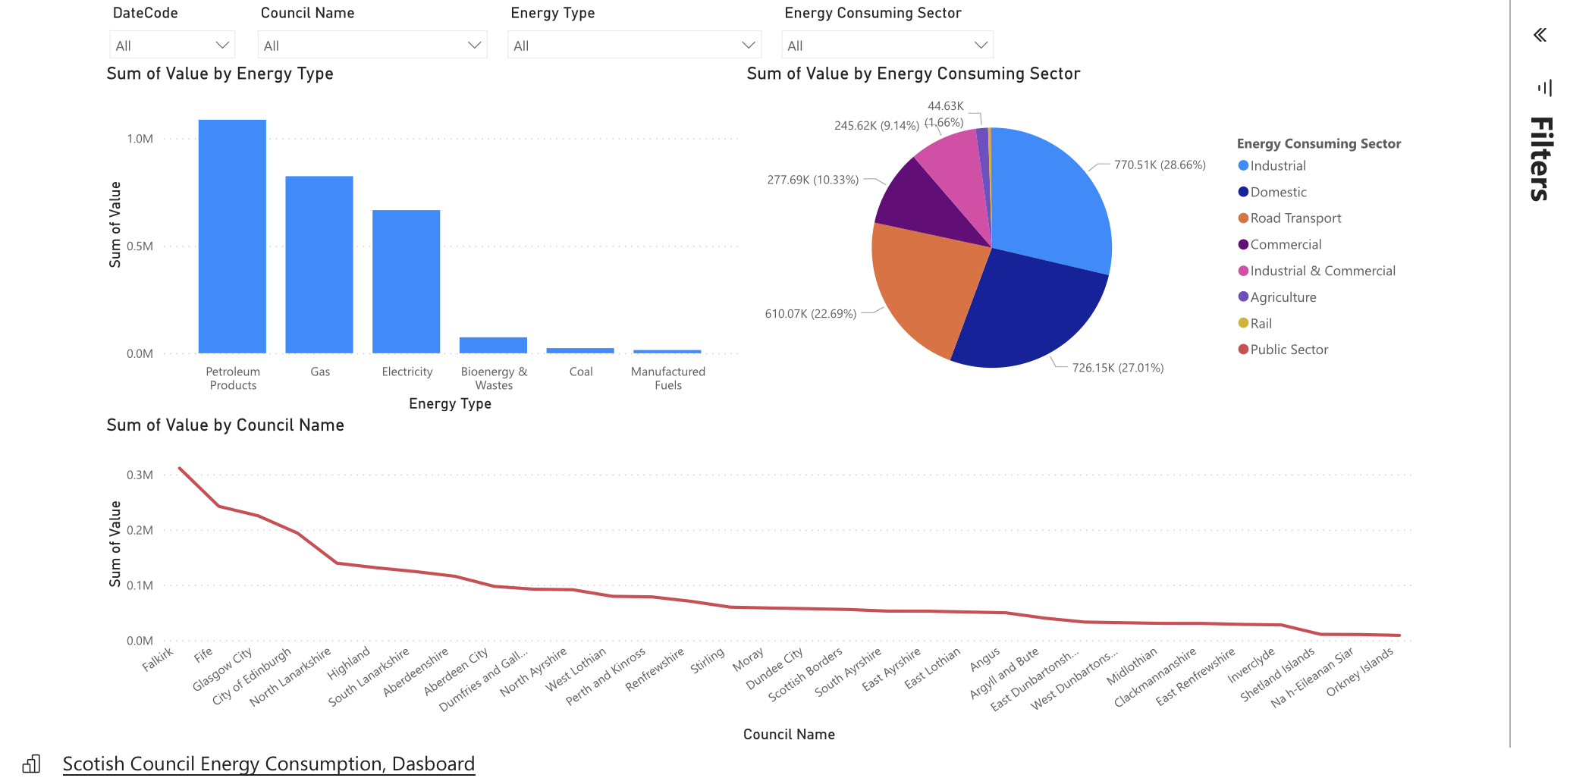
Microsoft Power BI Dashboard

Slide 5
EDA

Slide 6
Machine Learning and Deployment

Slide 7
Conclusion and future work

